Slide 1
Review 2.1
B.Tech Project (19ECE495)
Batch ID: 041
Multi-Class Classification and Detection of Knee Osteoarthritis From X- rays
MENTOR: Dr. Devi Vijayan
Dept. of Elec. and Commn. Engg.
Amrita School of Engineering, Coimbatore
CB.EN.U4ECE21008 | - | C RISHI VARDHAN REDDY
CB.EN.U4ECE21011 | - | D M SHAAHID
CB.EN.U4ECE21012 | - | DULAM SANTHOSH
CB.EN.U4ECE21033 | - | NUKALA SUMANTH

Slide 2
Introduction:
Knee osteoarthritis (KOA) is a common joint disorder characterized by the gradual degeneration of cartilage and underlying bone in the knee joint, leading to pain, stiffness, and reduced mobility.
KOA affects approximately 1 in 5 individuals in the general population and 1 in 3 people over the age of 50 [1], making it a significant contributor to impaired quality of life and daily functioning.
Early detection and accurate classification of KOA severity are critical for effective treatment, as timely interventions can prevent further joint damage and improve patient outcomes.
Current diagnostic methods, such as physical exams and X-ray imaging, are often subjective and may misclassify early stages of KOA, leading to delayed or inappropriate treatment.

Slide 3
Objective:
Validate the model's predictions using test data to assess its accuracy and Precision.
Compare the model's performance with existing state-of-the-art models.
Employ deep learning model to automatically categorize the severity of knee osteoarthritis into five grades (G-0 to G-4) based on the Kellgren and Lawrence classification system.

Slide 4
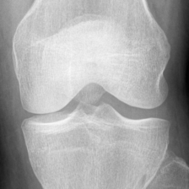
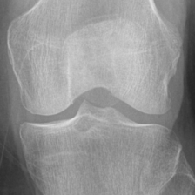
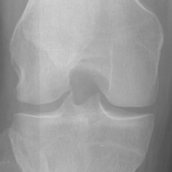
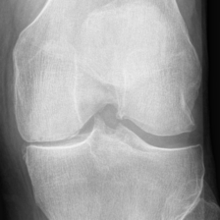
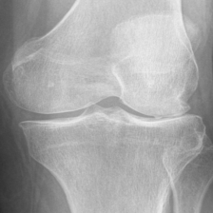
Data Preparation:
Dataset[2]:
The dataset used in the study is based on the Osteoarthritis Initiative (OAI) dataset.
The dataset contains 8,260 X-ray images of knee joints, graded according to the Kellgren-Lawrence (KL) grading scheme. The distribution of the dataset across KL grades is as follows:
  Grade 0: 3,253 images
  Grade 1: 1,495 images
  Grade 2: 2,175 images
  Grade 3: 1,086 images
  Grade 4: 251 images
Grade0 Grade1 Grade2 Grade3 Garde4

Slide 5
Data Preparation:
 | GRADE 0 | GRADE 1 | GRADE 2 | GRADE 3 | GRADE 4
TEST | 639 | 296 | 447 | 223 | 51
TRAIN | 2286 | 1046 | 1516 | 757 | 173
EVALUATION | 328 | 153 | 212 | 106 | 27
TOTAL | 3253 | 1495 | 2175 | 1086 | 251
• The image dimensions are 224x224 pixels.

Slide 6
Data Preprocessing:
Median Filter
Normal Image
Histogram equalization
Processed Image
Unsharp masking
Augmentation

Slide 7
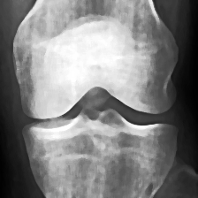
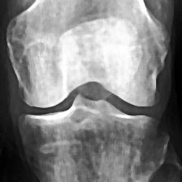
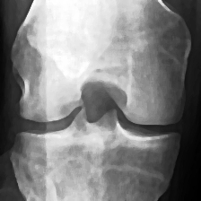
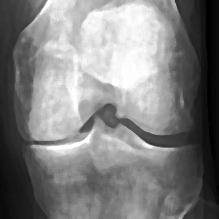
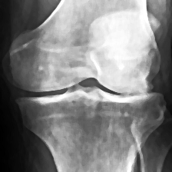
Grade0 Grade1 Grade2 Grade3 Garde4
Normal X-rays Images
Preprocessed X-ray Images

Slide 8
Data Preparation:
Augmented Dataset:
 | GRADE 0 | GRADE 1 | GRADE 2 | GRADE 3 | GRADE 4
TEST | 658 | 816 | 760 | 860 | 923
TRAIN | 1600 | 1600 | 1600 | 1600 | 1600
EVALUATION | 400 | 400 | 400 | 400 | 400
TOTAL | 2658 | 2816 | 2760 | 2860 | 2923
• 14017 augmented images of dimensions 224x224.

Slide 9
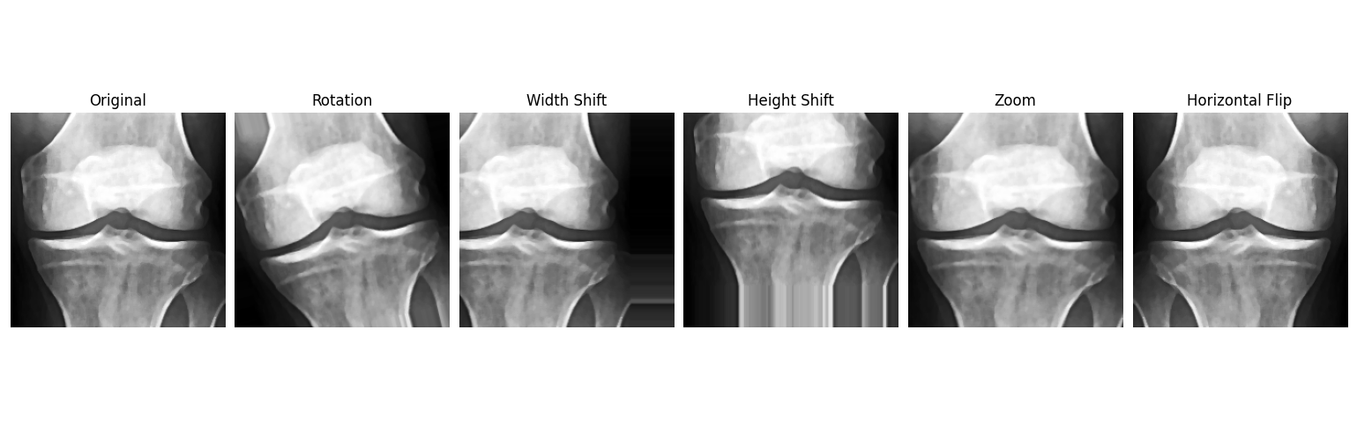
Augmentation:

Slide 10
VGG16:
Layers: VGG16 has 16 weight layers:
1.13 convolutional layers
2. 3 fully connected layers
3. Max-pooling layers after some of the convolutional layers.
VGG16 is commonly used as a pretrained model, meaning it can be fine-tuned for specific tasks such as object detection and image classification.

Slide 11
EfficientNetV2B0
EfficientNet, introduced by Google AI researchers in 2019, excels in tasks like object detection and image segmentation.
It employs compound scaling to optimize model dimensions—width, depth, and resolution.
The architecture achieves efficiency without compromising accuracy, overcoming traditional accuracy-resource trade-offs.
The EfficientNetV2B0 architecture consists of 9 layers in total. These layers include, Conv2D Layers, Global Average Pooling Layer.

Slide 12
RESNET50:
ResNet-50 was developed by Microsoft Research Asia and released in 2015.
50 layers in total, consisting of:
1 Conv layer (7x7 convolution)
1 Max-pooling layer
16 Residual blocks (each consisting of 3 convolutional layers)
Fully connected (FC) layer
ResNet-50 is a convolutional neural network (CNN) that excels at image classification.
Feature Hierarchy in ResNet50 are Low-level features and High-level features.

Slide 13
Results:
Model | Accuracy | Precision | Recall | F1- score
VGG- 16 | 0.8616 | 0.9012 | 0.8616 | 0.8231
ResNet50 | 0.8382 | 0.9087 | 0.8382 | 0.7822
EfficientNetB2V0 | 0.8708 | 0.8881 | 0.8708 | 0.8486

Slide 14
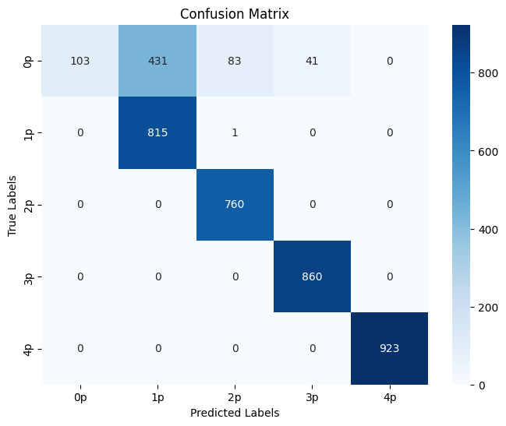
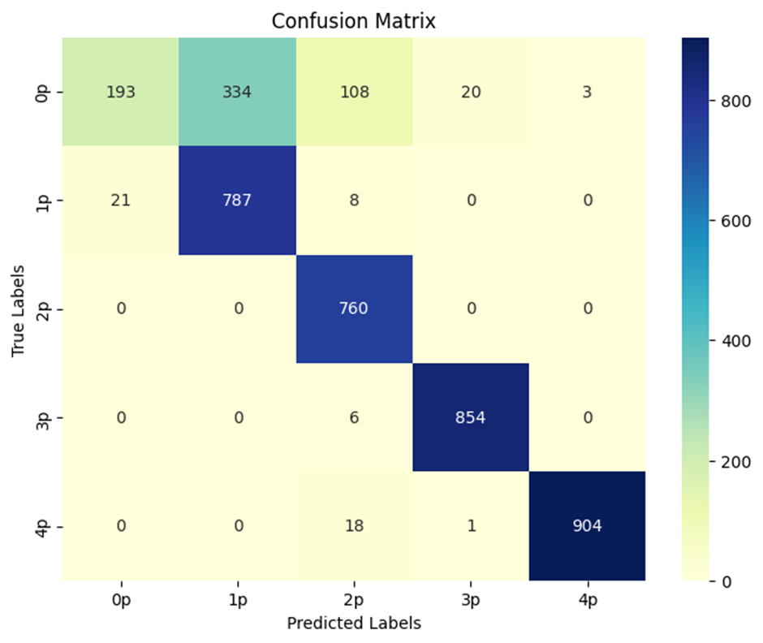
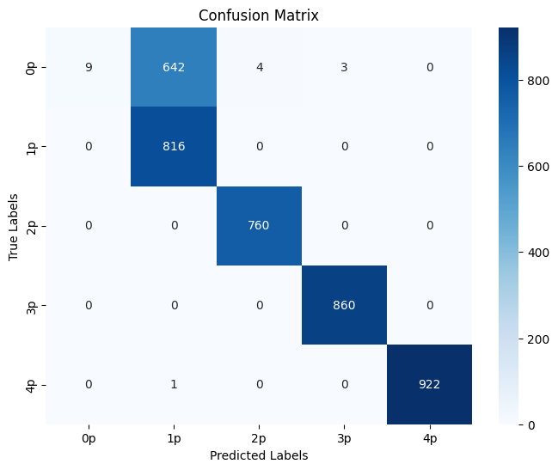
Confusion Matrix:
VGG16 EfficientNetV2B0 RESNET50

Slide 15
Methodology:
Dataset
Total 10000 images
2000 (Grade 0 ) Images
Train 8000 images
Validation 2000 images
PREPROCESSING
2000 (Grade 1 ) Images
Median Filter
ResNet
Grad CAM
Augmentation
2000 (Grade 2 ) Images
Histogram Equalization
Feature Extraction
2000 (Grade 3 ) Images
Convolutional Block Attention Module(CBAM)
2000 (Grade 4 ) Images
Unsharp Masking
SVM
Machine learning
classifier
Test Dataset
(To be given after
Training model)
Output Prediction
01-03-2025
Review 1.3
15

Slide 16
Preprocessing Technique | Accuracy | Precision
Median Filter + Histogram Equalization + Unsharp masking | 83.62 | 74.02
Without Preprocessing | 50.54 | 46.28

Slide 17
Fine tuning Proposed Model:
Model Type | Accuracy | Precision | Recall | F1-Score
Resnet + CBAM + RF | 83.57 | 74.38 | 83.57 | 77.69
Resnet + CBAM + XGBoost | 83.62 | 90.56 | 83.62 | 77.73
Resnet + CBAM + KNN | 83.62 | 73.23 | 84.32 | 77.54
Resnet + CBAM + SVM | 83.62 | 74.02 | 83.62 | 77.59

Slide 18
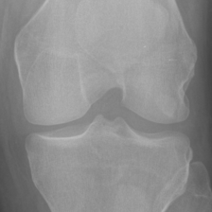
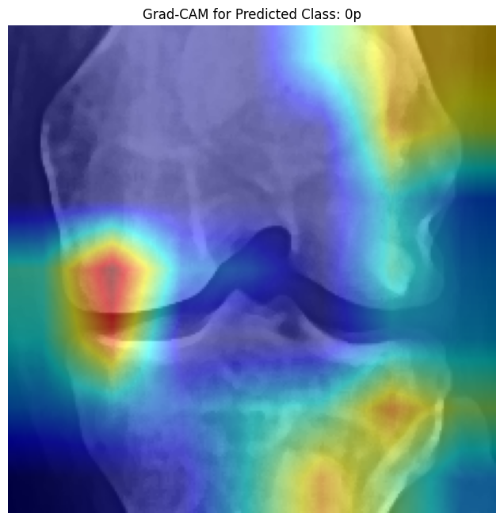
Results for Proposed Model:
Accuracy | Precision | Recall | F1-Score
83.62 | 90.56 | 83.62 | 77.73
Normal Image Grad-CAM
Actual class 1 Predicted Class 1

Slide 19
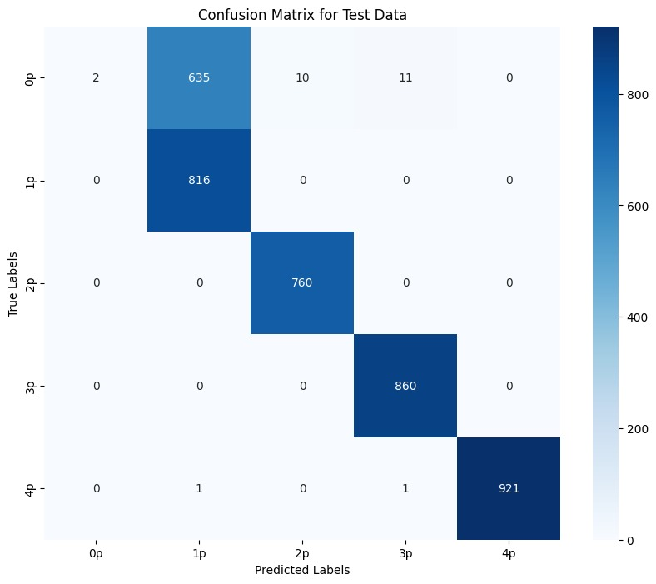
Confusion Matrix of our proposed model:

Slide 20
Timeline:
Review | Month | Milestone
1.1 | Aug 2024 | Data preparation, Data Preprocessing, Literature survey
1.2 | Sep 2024 | Literature survey, Analysis of state-of-the-art models
1.3 | Nov 2024 | Building of classification model
2.1 | Jan 2025 | Validation and performance comparison, Paper draft
2.2 | Mar 2025 | Paper Draft
2.3 | May 2025 (External Review) | Project Report / Dissertation

Slide 21
Deliverables:
Different combinations of preprocessing techniques were implemented.
We fine tuned our proposed model by using different machine learning models for classification.

Slide 22
References:
A. Mobasheri, C. S. Thudium, A.-C. Bay-Jensen, T. Maleitzke, S. Geissler, G. N. Duda, and T. Winkler, "Biomarkers for osteoarthritis: Current status and future prospects," Best Practice & Research Clinical Rheumatology, vol. 37, p. 101852, June 2023.
Chen, Pingjun (2018), “Knee Osteoarthritis Severity Grading Dataset”, Mendeley Data, V1. [Online]. Available: https://tinyurl.com/4h7pwaaa. [Accessed Sept. 12, 2024].

Slide 23
Thank You

